Slide 1
Local AI with CoreML and TensorFlow Lite - and More!
@ray_deck

Slide 2
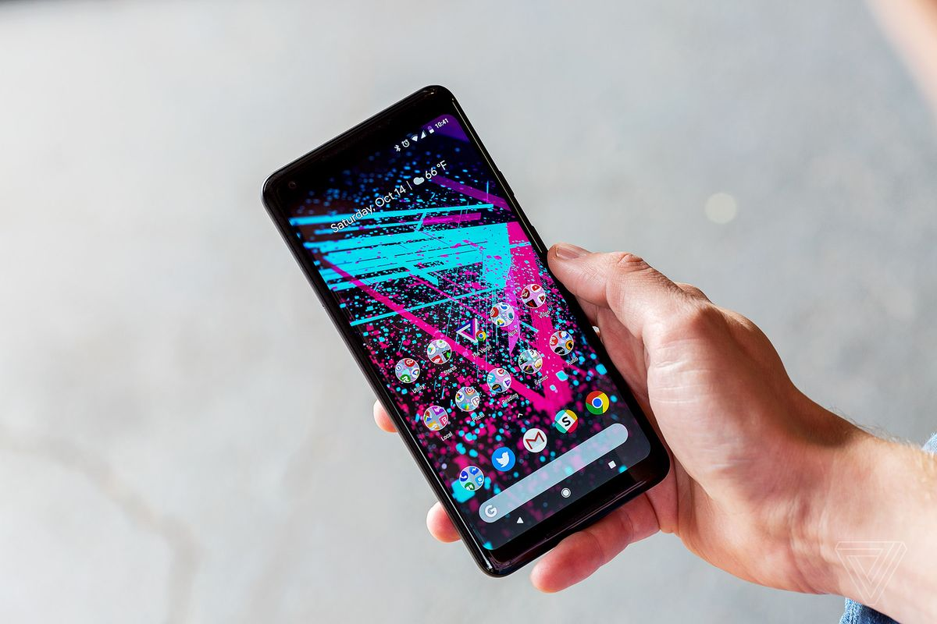
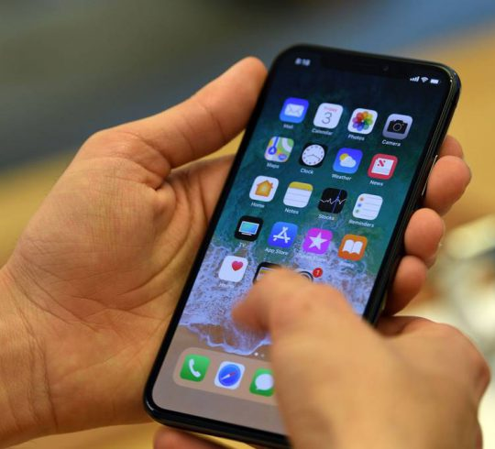

Slide 3
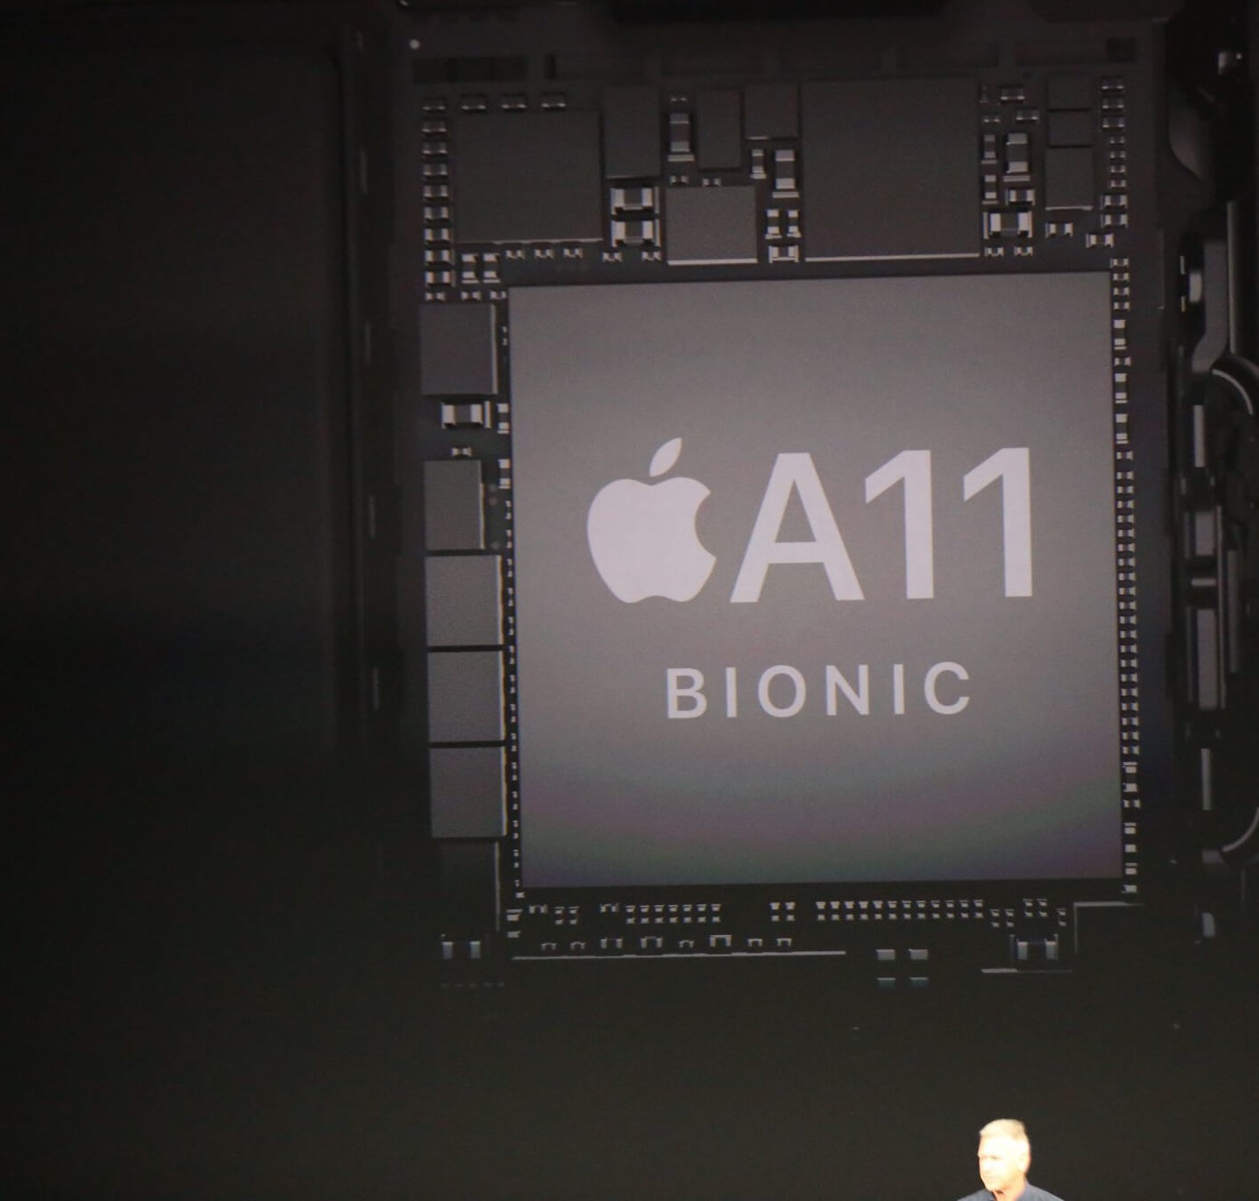
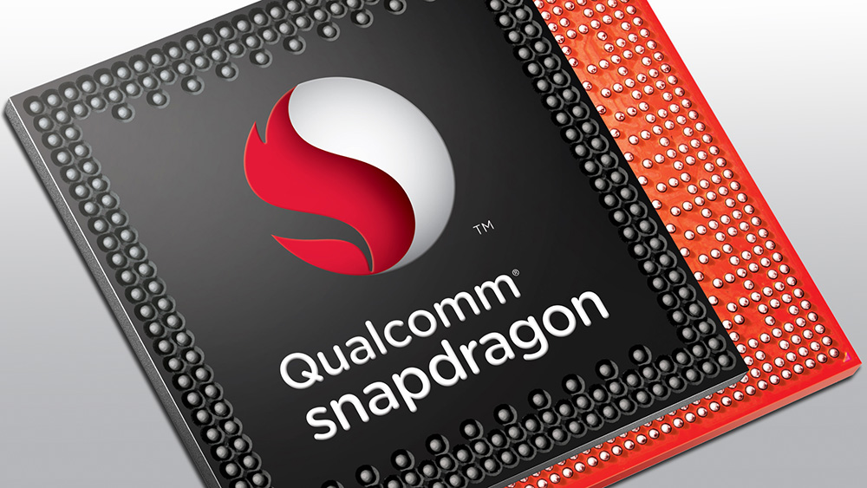

Slide 4
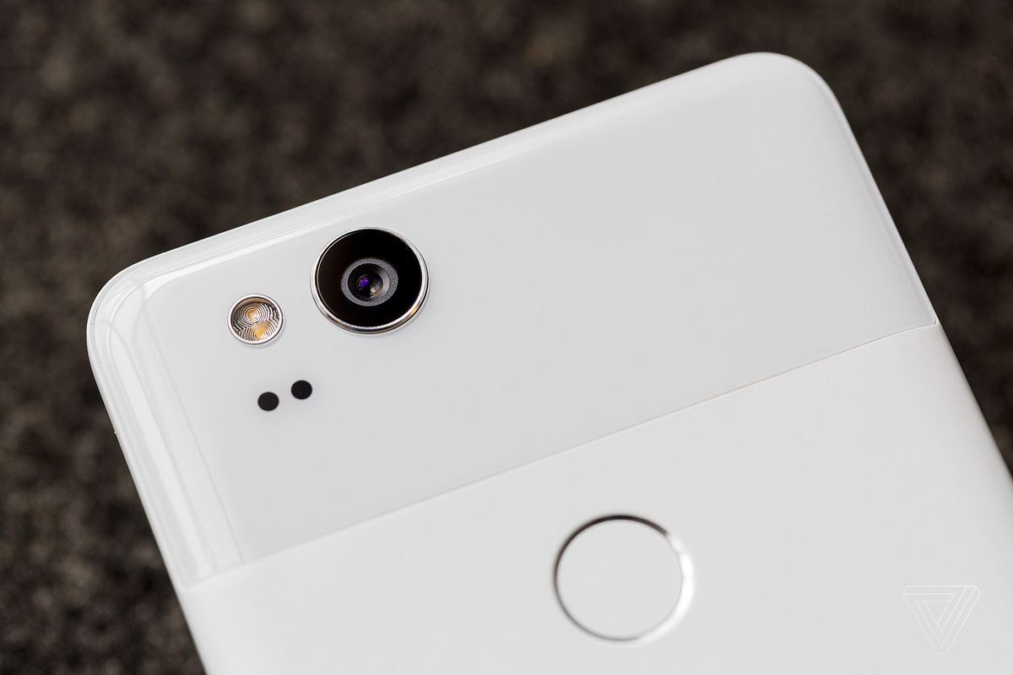
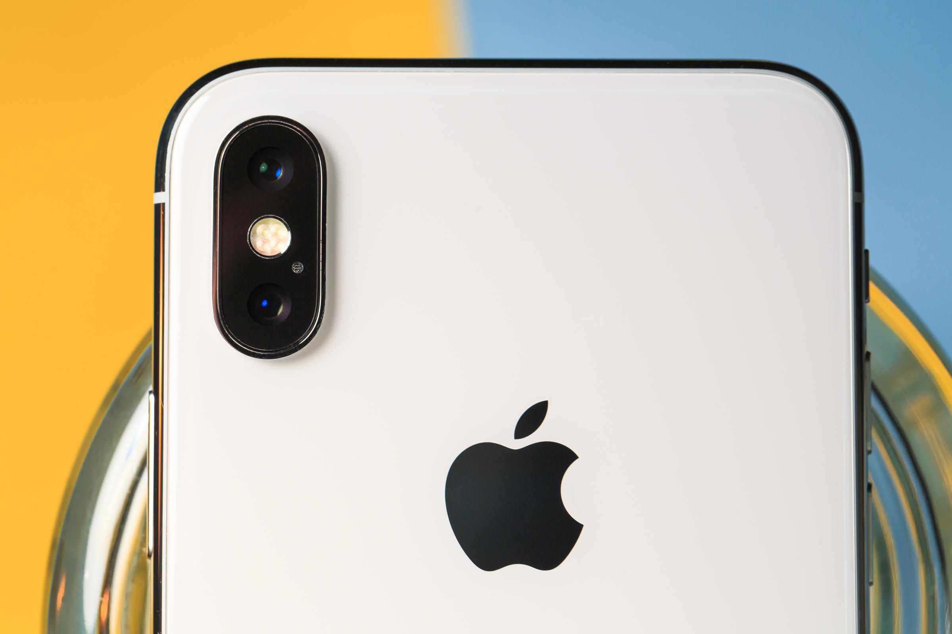

Slide 5
Artificial Intelligence Statistical Computing Machine Learning Stochastic Programming

Slide 6
Functions Written by Machines

Slide 7
= f( )
0.1489
0.0026
0.0128
0.0731
0.1212
0.0933
0.0110
0.0011
0.0432
0.0002
0.0299
0.0054
0.0255
0.0035
0.1043
0.1407
0.0958
0.0060
0.0008
0.0417
0.0002
0.0389
0.3200 | 0.5421 | 0.5110 | 0.7389 | 0.4918 | 0.9184
0.8660 | 0.3020 | 0.4890 | 0.6987 | 0.3051 | 0.4029
0.0722 | 0.6375 | 0.7953 | 0.1546 | 0.2867 | 0.9654
0.3608 | 0.6891 | 0.8220 | 0.0024 | 0.2030 | 0.1865
0.6227 | 0.2532 | 0.9418 | 0.8587 | 0.0778 | 0.5965
0.1612 | 0.2107 | 0.1784 | 0.5981 | 0.5417 | 0.3071
0.2835 | 0.8236 | 0.3139 | 0.1868 | 0.7756 | 0.1203
0.5113 | 0.8758 | 0.0920 | 0.9075 | 0.1681 | 0.7669
0.6540 | 0.9847 | 0.2407 | 0.0232 | 0.4423 | 0.8521
0.1045 | 0.6293 | 0.9488 | 0.3950 | 0.5043 | 0.7875
0.0377 | 0.1511 | 0.6241 | 0.1502 | 0.2732 | 0.9331
0.2222 | 0.6622 | 0.5402 | 0.7650 | 0.1721 | 0.3517
0.4795 | 0.8597 | 0.4049 | 0.7070 | 0.0784 | 0.6631
0.3131 | 0.7966 | 0.4261 | 0.7823 | 0.7319 | 0.0807
0.2659 | 0.7687 | 0.7874 | 0.8179 | 0.0292 | 0.4352
0.4201 | 0.2091 | 0.2931 | 0.3404 | 0.4661 | 0.6139
0.3099 | 0.1022 | 0.0893 | 0.3600 | 0.8400 | 0.5494
0.0287 | 0.7979 | 0.6785 | 0.1231 | 0.0385 | 0.0082
0.5974 | 0.5917 | 0.1183 | 0.8901 | 0.9990 | 0.8012
0.7279 | 0.8426 | 0.2705 | 0.7502 | 0.9465 | 0.5517
0.9324 | 0.1228 | 0.4561 | 0.0281 | 0.7467 | 0.2544
0.9296 | 0.9581 | 0.9300 | 0.1107 | 0.0081 | 0.5787
0.0548 | 0.6564 | 0.0637 | 0.5374 | 0.1792 | 0.4786
0.3202 | 0.4883 | 0.9120 | 0.7424 | 0.8177 | 0.8120
0.8694 | 0.7283 | 0.8922 | 0.2756 | 0.9849 | 0.4665
0.2098 | 0.9957 | 0.5271 | 0.7638 | 0.4820 | 0.9617
0.2385 | 0.8299 | 0.3855 | 0.9500 | 0.3676 | 0.2845
0.1923 | 0.7167 | 0.6323 | 0.9345 | 0.2605 | 0.0331
0.5322 | 0.1652 | 0.4930 | 0.2563 | 0.5717 | 0.1103
0.7212 | 0.4764 | 0.9196 | 0.6196 | 0.4345 | 0.6993
0.8939 | 0.5753 | 0.7510 | 0.1955 | 0.7078 | 0.9869
0.9766 | 0.7216 | 0.0188 | 0.8569 | 0.8033 | 0.7709
0.3885 | 0.6761 | 0.4612 | 0.8000 | 0.8435 | 0.8812

Slide 8
y = f(x)

Slide 9
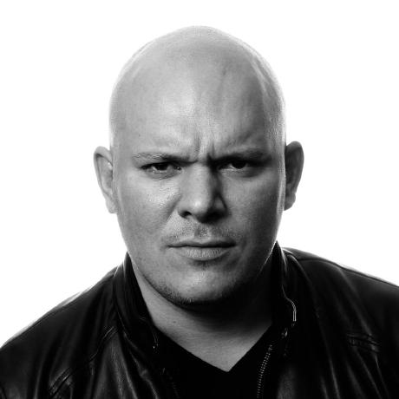
0.3200 | 0.5421 | 0.5110 | 0.7389 | 0.4918 | 0.9184
0.8660 | 0.3020 | 0.4890 | 0.6987 | 0.3051 | 0.4029
0.0722 | 0.6375 | 0.7953 | 0.1546 | 0.2867 | 0.9654
0.3608 | 0.6891 | 0.8220 | 0.0024 | 0.2030 | 0.1865
0.6227 | 0.2532 | 0.9418 | 0.8587 | 0.0778 | 0.5965
0.1612 | 0.2107 | 0.1784 | 0.5981 | 0.5417 | 0.3071
0.2835 | 0.8236 | 0.3139 | 0.1868 | 0.7756 | 0.1203
0.5113 | 0.8758 | 0.0920 | 0.9075 | 0.1681 | 0.7669
0.6540 | 0.9847 | 0.2407 | 0.0232 | 0.4423 | 0.8521
0.1045 | 0.6293 | 0.9488 | 0.3950 | 0.5043 | 0.7875
0.0377 | 0.1511 | 0.6241 | 0.1502 | 0.2732 | 0.9331
0.2222 | 0.6622 | 0.5402 | 0.7650 | 0.1721 | 0.3517
0.4795 | 0.8597 | 0.4049 | 0.7070 | 0.0784 | 0.6631
0.3131 | 0.7966 | 0.4261 | 0.7823 | 0.7319 | 0.0807
0.2659 | 0.7687 | 0.7874 | 0.8179 | 0.0292 | 0.4352
0.4201 | 0.2091 | 0.2931 | 0.3404 | 0.4661 | 0.6139
0.3099 | 0.1022 | 0.0893 | 0.3600 | 0.8400 | 0.5494
0.0287 | 0.7979 | 0.6785 | 0.1231 | 0.0385 | 0.0082
0.5974 | 0.5917 | 0.1183 | 0.8901 | 0.9990 | 0.8012
0.7279 | 0.8426 | 0.2705 | 0.7502 | 0.9465 | 0.5517
0.9324 | 0.1228 | 0.4561 | 0.0281 | 0.7467 | 0.2544
0.9296 | 0.9581 | 0.9300 | 0.1107 | 0.0081 | 0.5787
0.0548 | 0.6564 | 0.0637 | 0.5374 | 0.1792 | 0.4786
0.3202 | 0.4883 | 0.9120 | 0.7424 | 0.8177 | 0.8120
0.8694 | 0.7283 | 0.8922 | 0.2756 | 0.9849 | 0.4665
0.2098 | 0.9957 | 0.5271 | 0.7638 | 0.4820 | 0.9617
0.2385 | 0.8299 | 0.3855 | 0.9500 | 0.3676 | 0.2845
0.1923 | 0.7167 | 0.6323 | 0.9345 | 0.2605 | 0.0331
0.5322 | 0.1652 | 0.4930 | 0.2563 | 0.5717 | 0.1103
0.7212 | 0.4764 | 0.9196 | 0.6196 | 0.4345 | 0.6993
0.8939 | 0.5753 | 0.7510 | 0.1955 | 0.7078 | 0.9869
0.9766 | 0.7216 | 0.0188 | 0.8569 | 0.8033 | 0.7709
0.3885 | 0.6761 | 0.4612 | 0.8000 | 0.8435 | 0.8812

Slide 10
0.3200 | 0.5421 | 0.5110 | 0.7389 | 0.4918 | 0.9184
0.8660 | 0.3020 | 0.4890 | 0.6987 | 0.3051 | 0.4029
0.0722 | 0.6375 | 0.7953 | 0.1546 | 0.2867 | 0.9654
0.3608 | 0.6891 | 0.8220 | 0.0024 | 0.2030 | 0.1865
0.6227 | 0.2532 | 0.9418 | 0.8587 | 0.0778 | 0.5965
0.1612 | 0.2107 | 0.1784 | 0.5981 | 0.5417 | 0.3071
0.2835 | 0.8236 | 0.3139 | 0.1868 | 0.7756 | 0.1203
0.5113 | 0.8758 | 0.0920 | 0.9075 | 0.1681 | 0.7669
0.6540 | 0.9847 | 0.2407 | 0.0232 | 0.4423 | 0.8521
0.1045 | 0.6293 | 0.9488 | 0.3950 | 0.5043 | 0.7875
0.0377 | 0.1511 | 0.6241 | 0.1502 | 0.2732 | 0.9331
’Murica!
0.2222 | 0.6622 | 0.5402 | 0.7650 | 0.1721 | 0.3517
0.4795 | 0.8597 | 0.4049 | 0.7070 | 0.0784 | 0.6631
0.3131 | 0.7966 | 0.4261 | 0.7823 | 0.7319 | 0.0807
0.2659 | 0.7687 | 0.7874 | 0.8179 | 0.0292 | 0.4352
0.4201 | 0.2091 | 0.2931 | 0.3404 | 0.4661 | 0.6139
0.3099 | 0.1022 | 0.0893 | 0.3600 | 0.8400 | 0.5494
0.0287 | 0.7979 | 0.6785 | 0.1231 | 0.0385 | 0.0082
0.5974 | 0.5917 | 0.1183 | 0.8901 | 0.9990 | 0.8012
0.7279 | 0.8426 | 0.2705 | 0.7502 | 0.9465 | 0.5517
0.9324 | 0.1228 | 0.4561 | 0.0281 | 0.7467 | 0.2544
0.9296 | 0.9581 | 0.9300 | 0.1107 | 0.0081 | 0.5787
0.0548 | 0.6564 | 0.0637 | 0.5374 | 0.1792 | 0.4786
0.3202 | 0.4883 | 0.9120 | 0.7424 | 0.8177 | 0.8120
0.8694 | 0.7283 | 0.8922 | 0.2756 | 0.9849 | 0.4665
0.2098 | 0.9957 | 0.5271 | 0.7638 | 0.4820 | 0.9617
0.2385 | 0.8299 | 0.3855 | 0.9500 | 0.3676 | 0.2845
0.1923 | 0.7167 | 0.6323 | 0.9345 | 0.2605 | 0.0331
0.5322 | 0.1652 | 0.4930 | 0.2563 | 0.5717 | 0.1103
0.7212 | 0.4764 | 0.9196 | 0.6196 | 0.4345 | 0.6993
0.8939 | 0.5753 | 0.7510 | 0.1955 | 0.7078 | 0.9869
0.9766 | 0.7216 | 0.0188 | 0.8569 | 0.8033 | 0.7709
0.3885 | 0.6761 | 0.4612 | 0.8000 | 0.8435 | 0.8812

Slide 11
= f( )
65% | Ken Wheeler
12% | ‘Murica

Slide 12


Mobile Vision TensorFlow Lite
VisionKit CoreML
Tesseract OCR
Caffe2

Slide 13
Privacy Performance Personalization

Slide 14
Conv2D MaxPool ReLU Sigmoid TanH LSTM GRU

Slide 15
Data
Training
Packaging
Inference
Application

Slide 16
react-native-vision

Slide 17
Reality is Declarative

Slide 18
Make the World Your Provider

Slide 19
Inference

Slide 20


Slide 21
Models Written by Machines

Slide 23

0.3200 | 0.5421 | 0.5110 | 0.7389 | 0.4918 | 0.9184
0.8660 | 0.3020 | 0.4890 | 0.6987 | 0.3051 | 0.4029
0.0722 | 0.6375 | 0.7953 | 0.1546 | 0.2867 | 0.9654
0.3608 | 0.6891 | 0.8220 | 0.0024 | 0.2030 | 0.1865
0.6227 | 0.2532 | 0.9418 | 0.8587 | 0.0778 | 0.5965
0.1612 | 0.2107 | 0.1784 | 0.5981 | 0.5417 | 0.3071
0.2835 | 0.8236 | 0.3139 | 0.1868 | 0.7756 | 0.1203
0.5113 | 0.8758 | 0.0920 | 0.9075 | 0.1681 | 0.7669
0.6540 | 0.9847 | 0.2407 | 0.0232 | 0.4423 | 0.8521
0.1045 | 0.6293 | 0.9488 | 0.3950 | 0.5043 | 0.7875
0.0377 | 0.1511 | 0.6241 | 0.1502 | 0.2732 | 0.9331
0.2222 | 0.6622 | 0.5402 | 0.7650 | 0.1721 | 0.3517
0.4795 | 0.8597 | 0.4049 | 0.7070 | 0.0784 | 0.6631
0.3131 | 0.7966 | 0.4261 | 0.7823 | 0.7319 | 0.0807
0.2659 | 0.7687 | 0.7874 | 0.8179 | 0.0292 | 0.4352
0.4201 | 0.2091 | 0.2931 | 0.3404 | 0.4661 | 0.6139
0.3099 | 0.1022 | 0.0893 | 0.3600 | 0.8400 | 0.5494
0.0287 | 0.7979 | 0.6785 | 0.1231 | 0.0385 | 0.0082
0.5974 | 0.5917 | 0.1183 | 0.8901 | 0.9990 | 0.8012
0.7279 | 0.8426 | 0.2705 | 0.7502 | 0.9465 | 0.5517
0.9324 | 0.1228 | 0.4561 | 0.0281 | 0.7467 | 0.2544
0.9296 | 0.9581 | 0.9300 | 0.1107 | 0.0081 | 0.5787
0.0548 | 0.6564 | 0.0637 | 0.5374 | 0.1792 | 0.4786
0.3202 | 0.4883 | 0.9120 | 0.7424 | 0.8177 | 0.8120
0.8694 | 0.7283 | 0.8922 | 0.2756 | 0.9849 | 0.4665
0.2098 | 0.9957 | 0.5271 | 0.7638 | 0.4820 | 0.9617
0.2385 | 0.8299 | 0.3855 | 0.9500 | 0.3676 | 0.2845
0.1923 | 0.7167 | 0.6323 | 0.9345 | 0.2605 | 0.0331
0.5322 | 0.1652 | 0.4930 | 0.2563 | 0.5717 | 0.1103
0.7212 | 0.4764 | 0.9196 | 0.6196 | 0.4345 | 0.6993
0.8939 | 0.5753 | 0.7510 | 0.1955 | 0.7078 | 0.9869
0.9766 | 0.7216 | 0.0188 | 0.8569 | 0.8033 | 0.7709
0.3885 | 0.6761 | 0.4612 | 0.8000 | 0.8435 | 0.8812

Slide 24
Small Giants

Slide 25
Local Intelligence
@ray_deck

Slide 26
Wadsworth Constant

Slide 27


Slide 28
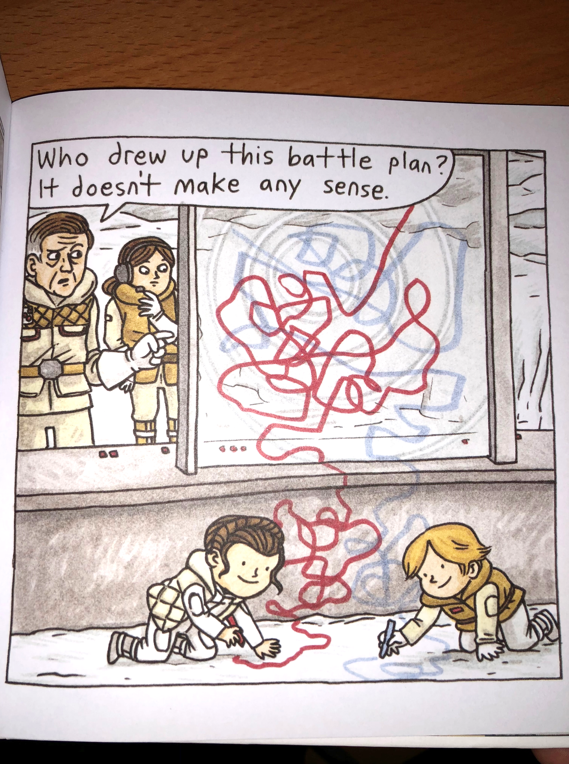

Slide 29
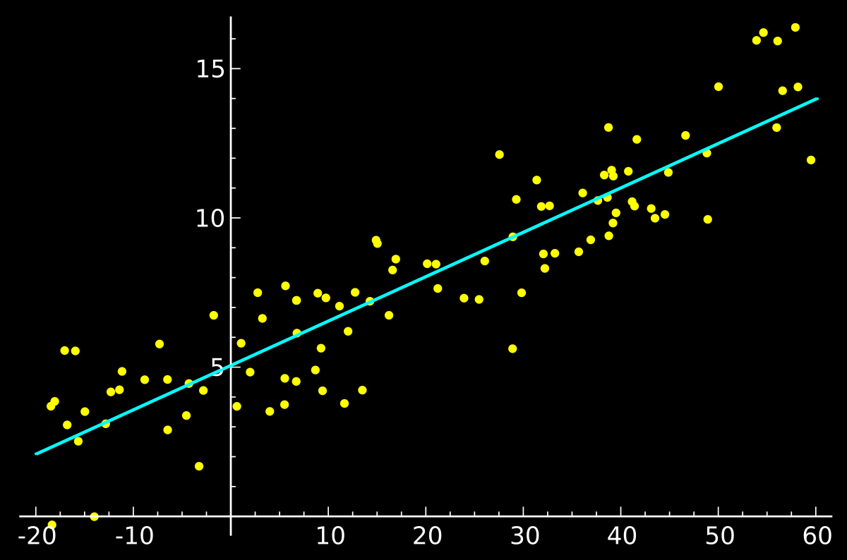
y = mx + b

Slide 30
Differentiation

Slide 31
High-Dimensional Numbers

Slide 32
High-Dimensional Vectors

Slide 33
High-Dimensional Arrays

Slide 34
0.3200 | 0.5421 | 0.5110 | 0.7389 | 0.4918 | 0.9184
0.8660 | 0.3020 | 0.4890 | 0.6987 | 0.3051 | 0.4029
0.0722 | 0.6375 | 0.7953 | 0.1546 | 0.2867 | 0.9654
0.3608 | 0.6891 | 0.8220 | 0.0024 | 0.2030 | 0.1865
0.6227 | 0.2532 | 0.9418 | 0.8587 | 0.0778 | 0.5965
0.1612 | 0.2107 | 0.1784 | 0.5981 | 0.5417 | 0.3071
0.2835 | 0.8236 | 0.3139 | 0.1868 | 0.7756 | 0.1203
0.5113 | 0.8758 | 0.0920 | 0.9075 | 0.1681 | 0.7669
0.6540 | 0.9847 | 0.2407 | 0.0232 | 0.4423 | 0.8521
0.1045 | 0.6293 | 0.9488 | 0.3950 | 0.5043 | 0.7875
0.0377 | 0.1511 | 0.6241 | 0.1502 | 0.2732 | 0.9331
0.2222 | 0.6622 | 0.5402 | 0.7650 | 0.1721 | 0.3517
0.4795 | 0.8597 | 0.4049 | 0.7070 | 0.0784 | 0.6631
0.3131 | 0.7966 | 0.4261 | 0.7823 | 0.7319 | 0.0807
0.2659 | 0.7687 | 0.7874 | 0.8179 | 0.0292 | 0.4352
0.4201 | 0.2091 | 0.2931 | 0.3404 | 0.4661 | 0.6139
0.3099 | 0.1022 | 0.0893 | 0.3600 | 0.8400 | 0.5494
0.0287 | 0.7979 | 0.6785 | 0.1231 | 0.0385 | 0.0082
0.5974 | 0.5917 | 0.1183 | 0.8901 | 0.9990 | 0.8012
0.7279 | 0.8426 | 0.2705 | 0.7502 | 0.9465 | 0.5517
0.9324 | 0.1228 | 0.4561 | 0.0281 | 0.7467 | 0.2544
0.9296 | 0.9581 | 0.9300 | 0.1107 | 0.0081 | 0.5787
0.0548 | 0.6564 | 0.0637 | 0.5374 | 0.1792 | 0.4786
0.3202 | 0.4883 | 0.9120 | 0.7424 | 0.8177 | 0.8120
0.8694 | 0.7283 | 0.8922 | 0.2756 | 0.9849 | 0.4665
0.2098 | 0.9957 | 0.5271 | 0.7638 | 0.4820 | 0.9617
0.2385 | 0.8299 | 0.3855 | 0.9500 | 0.3676 | 0.2845
0.1923 | 0.7167 | 0.6323 | 0.9345 | 0.2605 | 0.0331
0.5322 | 0.1652 | 0.4930 | 0.2563 | 0.5717 | 0.1103
0.7212 | 0.4764 | 0.9196 | 0.6196 | 0.4345 | 0.6993
0.8939 | 0.5753 | 0.7510 | 0.1955 | 0.7078 | 0.9869
0.9766 | 0.7216 | 0.0188 | 0.8569 | 0.8033 | 0.7709
0.3885 | 0.6761 | 0.4612 | 0.8000 | 0.8435 | 0.8812

Slide 35
0.1489
0.0026
0.0128
0.0731
0.1212
0.0933
0.0110
0.0011
0.0432
0.0002
0.0299
0.0054
0.0255
0.0035
0.1043
0.1407
0.0958
0.0060
0.0008
0.0417
0.0002
0.0389
35% | SwiftFest Logo
24% | Swift Logo
12% | Bird

Slide 36
Conv2D MaxPool ReLU Sigmoid TanH LSTM GRU

Slide 37

Code
Caffe
Data
2013

Slide 39

Code
Caffe
Data
2012
2015

Slide 40
Model as Data Structure Model as Code

Slide 41
Automatic Differentiation

Slide 42

Code
Caffe
Data
2012
2015
2016

Slide 43

Code
Caffe
Data
2012
2015
2016

Slide 44


Slide 45
File Specification API Conversion Tools

Slide 46
ProtoBuf
apple.github.io/coremltools/coremlspecification

Slide 47
Feature Engineering

Slide 48

Input Conversion
Execution
Metal
Output Conversion
35% | SwiftFest Logo
24% | Swift Logo
12% | Bird

Slide 49
MLModel VisionKit NSLinguisticTagger GameplayKit

Slide 50
VNRequest

Slide 51
VNCoreMLRequest

Slide 52
VNClassificationObservation

Slide 53
MLModel.compile(url:)

Slide 54
DictionaryFeatureProvider

Slide 55
let c = MLModel.compile(url: u)
let m = MLModel(url: c)
let d:[String:Any] = [“input”: image]
let dfpin = MLDictionaryFeatureProvider(dictionary: d)
let fp = m.predict(dfp)
let dfpout = fp.featureValue(for: “labels”)
let dic = dfpout.dictionaryValue
let topResult = dic.first()

Slide 56
MLMultiArray

Slide 57
Input Conversion
Execution
Metal
MLMultiArray

Slide 58
MLMultiArray
Execution
Metal
Output Conversion
35% | SwiftFest Logo
24% | Swift Logo
12% | Bird

Slide 59
let m = MLModel(url: c)
let d:[String:Any] = [“input”: image]
let dfpin = MLDictionaryFeatureProvider(dictionary: d)
let fp = m.predict(dfp)
let c2 = MLModel.compile(url: u2)
let m2 = MLModel(url: c2)
let fp2 = m2.predict(fp)
let dfpout = fp2.featureValue(for: “labels”)
let dic = dfpout.dictionaryValue
let topResult = dic.first()

Slide 60
Bottlenecking

Slide 61
Composition

Slide 62
Packaging

Slide 63
Code
Caffe
Data
Time

Slide 64
Python
Bindings
C Runtime

Slide 65
Object-Oriented Interpreted

Slide 66


Slide 67
Python
Compiler & Runtime
Bindings
C Runtime

Slide 68
import Python
let np = Python.import("numpy")
let gzip = Python.import("gzip")

Slide 69
Automatic Differentiation

Slide 70
@differentiable

Slide 71
@differentiable(reverse, adjoint: dTanh)
func tanh(_ x: Float) -> Float {
// ... some super low-level assembly…}
func dTanh(x: Float, y: Float, seed: Float) -> Float {
return (1.0 - (y * y)) * seed
}
// Get the gradient function of tanh.
let dtanh_dx = #gradient(of: tanh)
dtanh_dx(2)

Slide 72
// Get the gradient function of foo with respect to the first parameter.
let dfoo_dx = #gradient(of: foo, withRespectTo: .0)
dfoo_dx(3, 4)

Slide 73
Eager Execution

Slide 74
Composition

Slide 75



Code
Caffe
Data
Time

Slide 78
Thank You
github.com/rhdeck/swiftfest-2018

